Slide 1
Procedures for Fire
Safety and Evacuation
Notes:
Welcome.
This training provides an overview of fire safety and fire evacuation procedures at Kirtland College.
This fire safety training presentation will give you a good understanding of fire safety and how to respond when you detect a fire or the fire alarm sounds in your building.
Having the knowledge to respond properly in these circumstances will help create a safer environment for you, and those around you.

Slide 2
Why Training?
Public Act 481 of 2014 was signed into law on January 10, 2015 by Governor Snyder and is effective March 15, 2015.
With the signing of this new Act, post-secondary educational institutions in Michigan “shall ensure that all instructional staff are trained in fire drill procedures before the beginning of each academic year.”
Colleges and Universities must attest to statutory compliance to the Bureau of Fire Services by January 10th of each year.
Notes:
Public Act 481 of 2014 amended Michigan’s Fire Prevention Code. As part of the legislation, any degree or certificate granting public or private college or university, junior college, or community college in the state shall ensure that all instructional staff are trained in fire drill procedures before the beginning of each academic year.
This training must be completed annually and the post-secondary institution must maintain a record of those trained and attest to compliance to the Michigan Bureau of Fire Services by January 10th of each year.

Slide 3

What’s In It for You?
You can apply these procedures on campus, at home or anywhere else.
You might save a life one day.
Sherzer Hall Fire, 1989
Notes:
The basic principles of fire safety can be applied to situations beyond the campus environment. They can be used at home or in other places such as shopping malls, restaurants or movie theaters.
Fire safety is especially important in the classroom. Our students have rehearsed fire safety in the school setting since kindergarten and they look to the teacher for direction and information when a situation arises.
By taking the right actions, you may save a life one day.

Slide 4
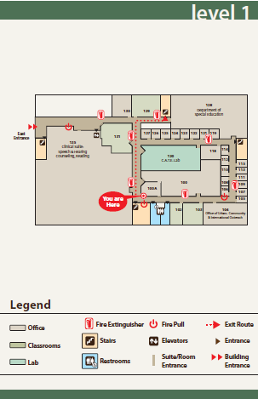
Preparation Responsibilities
Familiarize yourself with all exit routes and options to steer evacuees to the safest exit.
Familiarize yourself with the location of fire alarm pulls and fire extinguishers.
Notes:
Our knowledge, experience and education enables us to understand what is going on around us and helps us to determine if it is safe.
It is important that everyone is aware of their surroundings and the potential hazards they face.
Know the physical environment where you teach, have your office or conduct other activities. Identify where exits are located, the best routes to reach them and the location of fire alarm pulls and extinguishers.

Slide 5
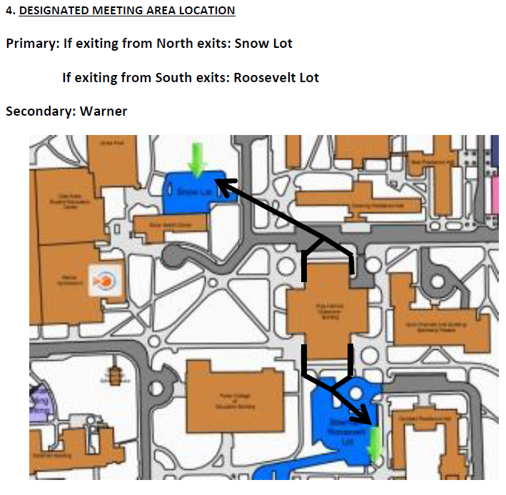
Preparation Responsibilities
Know where your building meeting areas are located.
If a meeting area has not been designated, meet outdoors on the upwind side of the building. The area should be at a safe distance and clear of emergency responders, their vehicles, and equipment.
Notes:
During a building fire, firefighters must determine as soon as possible whether or not all occupants have escaped. If not, they will attempt a rescue placing themselves at great risk of serious injury. Therefore, it is important to account for individuals.
One way of helping the accountability process, is to go to a designated meeting area. Buildings with completed emergency plans have predesignated meeting areas identified.
If a meeting area has not been previously designated, occupants should meet outdoors on the upwind side of the building. The meeting place should be at a safe distance and clear of emergency responders, their vehicles, and equipment.

Slide 6
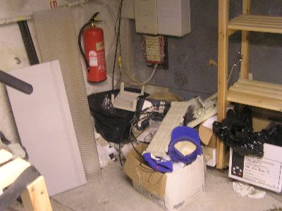
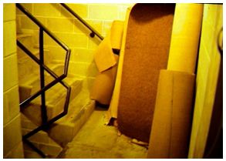
Preparation Responsibilities
Report any egress problems, nonfunctioning alarms, blocked open fire doors, or problems in keeping halls and stairways clear.
Notes:
It is common knowledge that prevention is always the best and most effective cure. With that in mind, practices and procedures to limit the risk of fires and ensure safe movement in the building should be practiced.
Each person has a responsibility to maintain a fire safe environment throughout the campus. Faculty, staff, and students are responsible for keeping their classrooms, labs, offices, residence hall rooms or work areas free of potential fire hazards.
Report safety concerns such as blocked passageways, nonfunctioning safety equipment or propped open fire doors to the facilities department.

Slide 7
Fire Response
If you discover a fire or see smoke:
Remember the word
R
A
C
E/E
Notes:
Rescue, Alarm, Contain, Evacuate/Extinguish (R.A.C.E..) is an acronym commonly used to help remember how to properly respond and when to use a fire extinguisher in an emergency.

Slide 8
Rescue
Remove all persons in immediate danger to safety.
During an emergency, people will tend to follow the directions of a person who is “in-charge”.
Instructional staff assume this “in-charge” role and need to provide clear, firm directions to the students and others in the room.
Notes:
Rescue or remove people from the area of danger. This includes directing people outside or, if unable to get out, to a safe area in the building. These areas, sometimes referred to as areas of refuge, are often in stairwells with closed fire rated doors.
Generally, rescue does not mean entering an area where there is fire or smoke. It is never safe to enter a room where the door is closed and the handle or door itself feels warm or hot.
During emergencies in the classroom, students typically look to the instructor for direction. Be prepared to provide clear, firm directions to those present in your classroom.

Slide 9
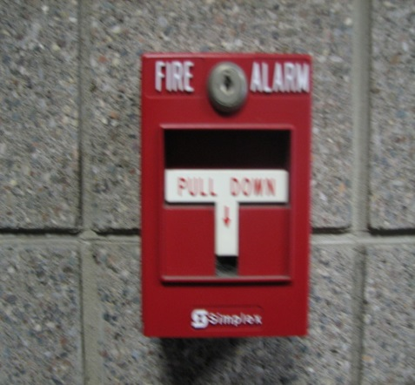
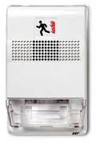
Alarm
Alert all people in the immediate area, pull the fire alarm, evacuate, and then report the smoke or fire. Dialing 355 from any Kirtland phone will connect to Public Safety. Calling 911 from a mobile phone will dial into a County Emergency Dispatch service.
When calling, inform the dispatcher of the location and if there are any known persons who cannot evacuate on their own for whatever reason.
Notes:
Sound the alarm by activating a pull station and calling public safety. Tell others of the danger.
You can contact Kirtland Public Safety by calling 355 from any Roscommon campus phone. Call 911 for the other campuses.
When calling, be ready to provide information to the dispatcher on the location of the fire and if there are any people needing rescue assistance.

Slide 10
Contain
Close all doors to contain the fire and smoke.
When evacuating, it is best to close all doors on your way out. Closing doors will aid in containing the fire to a smaller area.
Do not lock doors except under security-required conditions.
In labs, turn off any gas, oxygen or other valve which may control a hazardous substance.
Notes:
Contain the fire. Close windows and doors as you leave the area. Don’t lock doors.
If you are in a lab, turn off any gas, oxygen or other source which could increase the hazard during a fire. If you have knowledge of what chemicals are present at the location of a fire, or of other hazards in the vicinity of a fire, tell a Kirtland officer or fire department personnel on the scene.

Slide 11
Evacuate
You are required by state law to evacuate the building when a fire alarm is activated.
Leave the building by the nearest safe exit.
Do not use elevators.
Assist others in evacuating.
Notes:
The Michigan Fire Prevention Code require that you evacuate a building when the fire alarm sounds. Unless you have received official prior notification that you do not need to evacuate, you must leave the building.
Quickly assess the environment and walk to the nearest safe exit.
During a fire, do not use the elevator. It may lose electrical power and trap you, or may automatically open into a hazardous situation.
If you are able to provide assistance to those needing help during an evacuation, do so.
or Extinguish -- small fires can sometimes be extinguished using portable fire extinguishers, or it may be necessary to evacuate. As a rule, you should only try to put out fires the size of a small trash can.
REMEMBER
YOU ARE NOT REQUIRED TO FIGHT A FIRE USING A PORTABLE FIRE EXTINGUISHER.
WHEN IN DOUBT, DON’T ATTEMPT TO EXTINGUISH THE FIRE - EVACUATE!

Slide 12
Evacuate
If you or someone is unable to evacuate, call 911. Make sure that someone leaving the building is aware of your location.
After exiting, go to the designated meeting area.
If you decide to leave campus, let someone know you are safe.
Do not re-enter the building until instructed that it is safe to do so by emergency personnel.
Notes:
There will be some cases when outside conditions are extreme, and/or in the case of individuals with limited mobility, (especially due to the fact that elevators will not be available), evacuation to an area of refuge may be necessary. These areas are fire rated stairwells that are at least one fire barrier from the potential hazard and close to an exit point. If at all possible, notify the 911 dispatcher of your location or ask someone leaving the building to inform responders of the location.
Knowing that you are safe is important. Go to a meeting area so that you can be accounted for. If you decide to leave campus, let someone know you are safe.
It is important to not enter the building until it has been determined it is safe to do so by fire personnel. You will be informed when it is safe to re-enter the building.

Slide 13
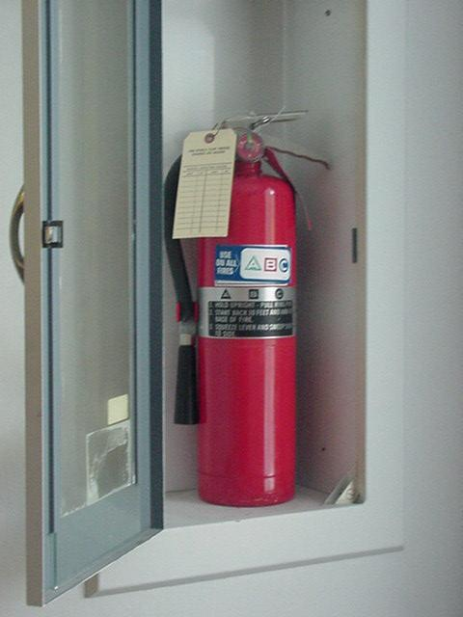
Extinguish
Attempt to extinguish only if:
  The fire is only in its early stage (no larger than an office trash can).
  You have the correct extinguisher for the type of fire.
  You are absolutely sure you can put the fire out.
  You will not endanger yourself or others.
Notes:
Fire extinguishers are to be used by trained individuals only. At no time should anyone jeopardize their safety or that of others in attempt to fight a fire.
Use a fire extinguisher only if all of these conditions are present:
You have alerted other occupants and someone has reported the fire to Public Safety; The fire is small and contained to a single object, such as a wastebasket;
You are safe from the toxic smoke produced by the fire;
You have a means of escape identified and the fire is not between you and the escape route;
You are physically capable of operating the extinguisher;
Your instincts tell you that it is safe to use an extinguisher.
If these conditions are not all present, or you have any doubts, leave the area immediately, closed the door behind you, activate the fire alarm (pull stations are located along exit pathways), and notify Public Safety.

Slide 14
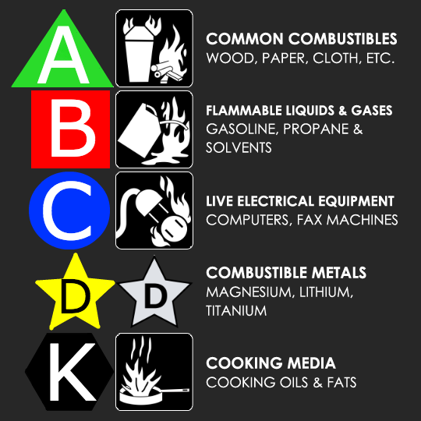
Extinguisher Classifications
Fire extinguishers are classified based on the type of fire they extinguish.
If you use the wrong type of fire extinguisher on the wrong type of fuel, you can, in fact, make matters worse.
Notes:
Different types of fires require different types of extinguishers. For example, a grease fire and an electrical fire require the use of different extinguishing agents to be effective and safely put the fire out. There are also multi-purpose fire extinguishers - such as those labeled "B-C" or "A-B-C“.
There are five classes of extinguishers, and each class is marked with a class specific color, geometric symbol, or picture as shown here.
Class A extinguishers are for ordinary combustible materials such as paper, wood, cardboard, and most plastics. Geometric symbol (green triangle)
Class B fires involve flammable or combustible liquids such as gasoline, kerosene, grease and oil. Geometric symbol (red square)
Class C fires involve electrical equipment, such as appliances, wiring, circuit breakers and outlets. Never use water to extinguish class C fires Geometric symbol (blue circle)
Class D fire extinguishers are commonly found in a chemical laboratory. They are for fires that involve combustible metals, such as magnesium, titanium, potassium and sodium. Geometric symbol (Yellow Decagon)
Class K fire extinguishers are for fires that involve cooking oils, trans-fats, or fats in cooking appliances and are typically found in restaurant and cafeteria kitchens. Geometric symbol (black hexagon)

Slide 15
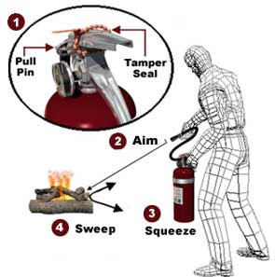
PASS
After getting a fire extinguisher:
  Check the pressure gauge
  Identify TWO routes of exit
  Find a partner to help you
  Stand 6 to 8 feet way from the fire
  Pull the pin
  Aim at the BASE of the fire
  Squeeze the operating handle
  Sweep gently from side to side
Notes:
Learn Pull-Aim-Squeeze-Sweep (PASS) to help you remember how to use fire extinguishers and what to do with them after use.
P - Pull the pin.
A - Aim low at the base of the fire. This is the where the fuel source is.
S - Squeeze the lever above the handle. Release to stop the flow.
S - Sweep from side to side. Move toward the fire, aiming low at its base. Sweep until all flames are extinguished. Watch for re-igniting.
Place any fire extinguisher that has been used on its side on the floor.

Slide 16
Final Points
You must evacuate a building when the fire alarm sounds.
Students look to instructional staff for direction.
You are not required to fight a fire using a portable fire extinguisher.
Notes:
Hopefully the information conveyed in this presentation has helped you to understand fire safety and evacuation procedures.
And finally, remember fire-safety is everyone’s responsibility. It is your responsibility to ensure that you know how to properly respond when there is a fire on campus.

Slide 17
Contact Information
In an emergency call 911
OR
  Kirtland Public Safety:
  Roscommon and Grayling campuses ext. 355
  In a non-emergency:
  Office of Public Safety
  989 275-5000 ext 322

