Slide 1

TITLE
SLIDE

Slide 2


TITLE SLIDE #2

Slide 3


Slide 7

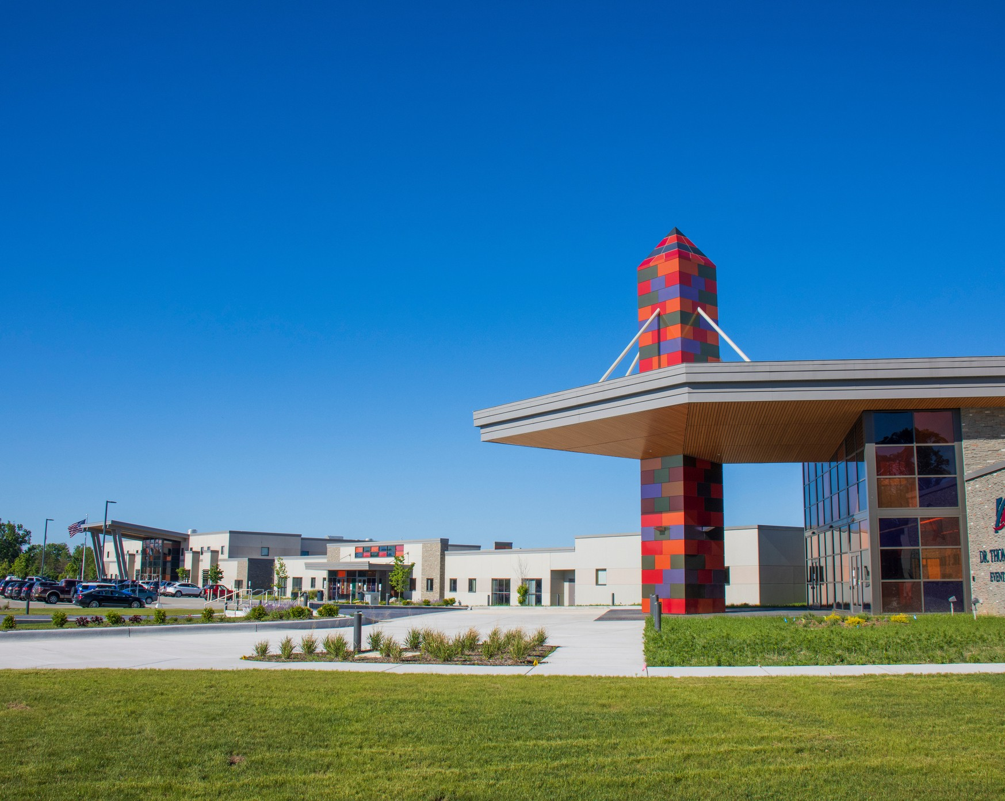
CONTACT US
4800 W. 4 Mile Road
Grayling, Mi 49738
989-275-5000
Kirtland.edu

